Slide 1


IDENTITY, CULTURE, AND SOCIAL HARMONY
Ayesha Ishtiaq

Slide 2

Identity
•Identity refers to the qualities, beliefs, personality, appearance, and experiences that make a person or group unique.
•Examples
Personal Identity
Cultural Identity
Social Identity
Gender Identity
National Identity
6. Professional Identity
7. Ethnic Identity
8. Religious Identity
9. Digital Identity
10.Collective Identity

Slide 3

CONCEPT AND DEVELOPMENT OF IDENTITY
-Erikson defines identity as a "fundamental organizing principle which develops constantly throughout the lifespan.“
-Identity involves the experiences, relationships, beliefs, values, and memories that make up a person's subjective sense of self. This helps create a continuous self-imagethat remains fairly constant even as new aspects of the self are developed or strengthened over time. Identity provides:

Slide 4

•Self-sameness: A sense of continuity within the self and in interaction with others
• Uniqueness: A frame to differentiate between self and interaction with others
•Psychosocial development: Mental and physical health for adolescents

Slide 5

BENEFITS OF IDENTITY
1) Commitment:
Resolving the crisis at this stage of development involves committing to a particular identity. This might involve committing to a career path, deciding what social groups to associate with, and even developing a sense of personal style.
2) Self-confidence:
Those who are able to develop a strong sense of identity are better able to have or a sense of trust in their abilities, qualities, and judgements.

Slide 6

3) Sense of independence:
Those who receive proper encouragement and reinforcement through personal exploration will emerge from this stage with a strong sense of self and a feeling of independence and control. Those who remain unsure of their beliefs and desires will remain insecure and confused about themselves and the future.
4) Fidelity:
Those who are successful develop fidelity, a psychological virtue characterized by the ability to relate to others and form genuine relationships. This ability plays an important role in the upcoming stage known as Fidelity

Slide 7

CULTURE
Definition
•Culture refers to the shared beliefs, customs, practices, values, and behaviors of a particular group of people.
•Explanation
• It includes everything from language, religion, and traditions to social habits, art, music, and food. Culture shapes how individuals within a society understand the world, communicate, and interact with each other. It can be passed down through generations and often evolves over time as societies change.

Slide 8
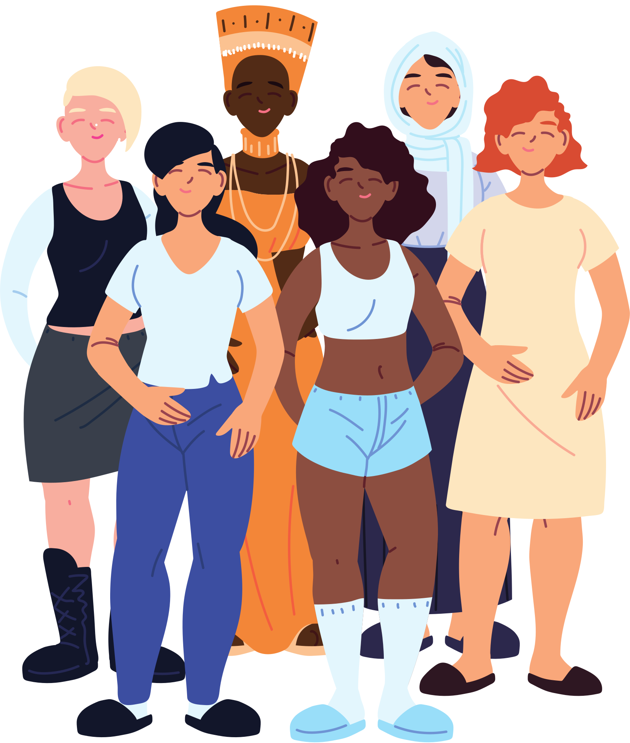
TYPES OF CULTURE
1.There are many types of cultures in society, but in our course, we discussed two main types these are:
2.Material Culture
3.Non-Material Culture

Slide 9

MATERIAL CULTURE
•Material culture refers to the physical objects, resources, and spaces that people use to define their culture.
•Examples of material culture include:
•Tools and Technology: Items such as smartphones, cars, or farming equipment.
•Buildings and Architecture: Structures such as homes, offices, temples, and monuments.
•Art and Artifacts: Paintings, sculptures, pottery, and jewelry.

Slide 10
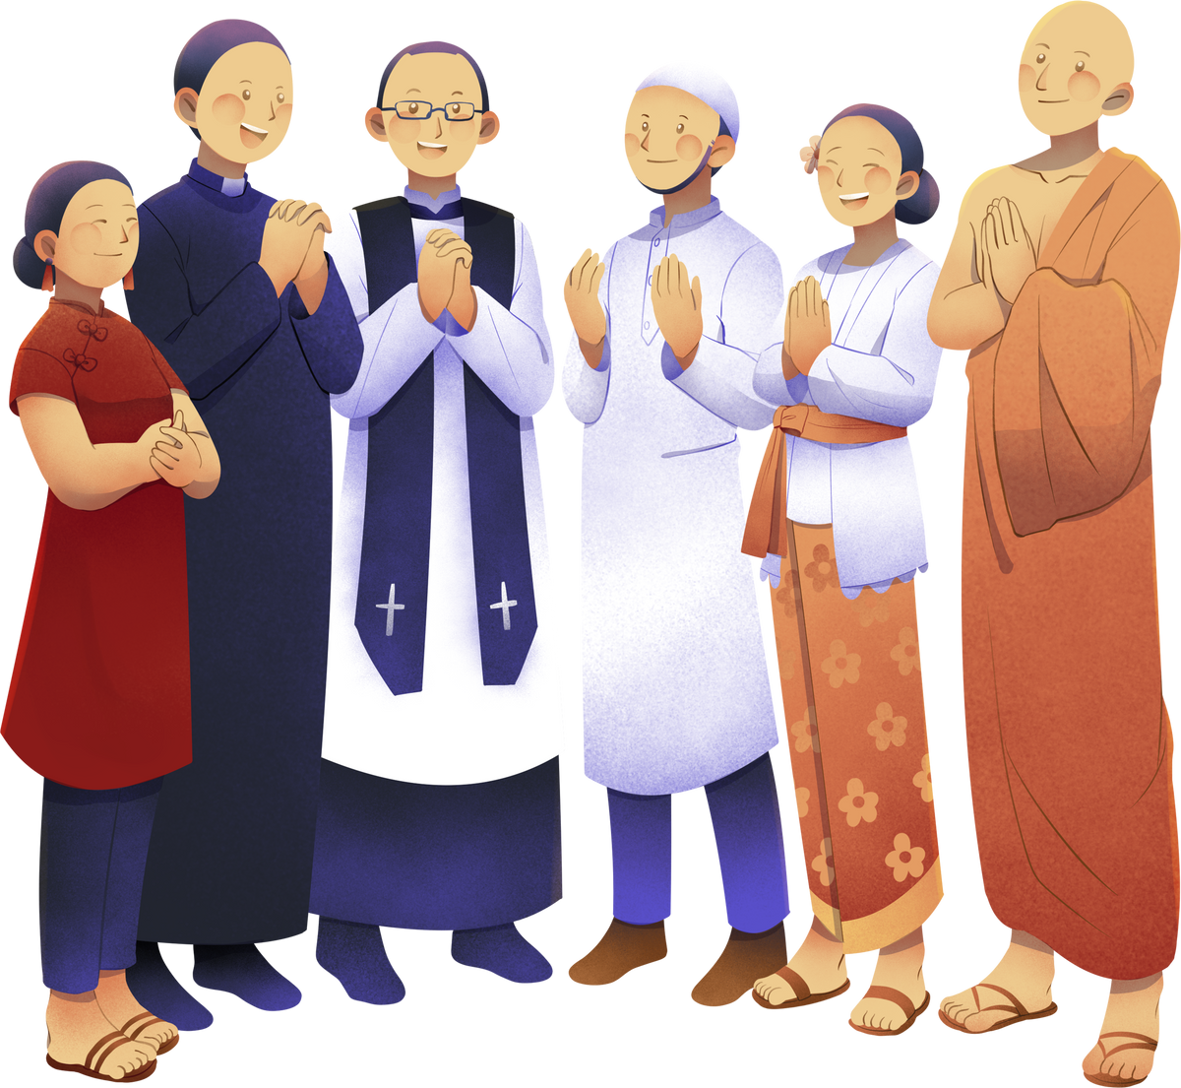
•Clothing: Fashion, traditional attire, and uniforms.
•Food and Cuisine: Specific dishes or methods of preparing food that are unique to a culture
•Non- Material culture
•Non-material culture refers to the intangible elements of culture that include ideas, beliefs, values, norms, language, and customs that influence how people live and interact with each other.

Slide 11
EXAMPLES INCLUDE:
•Beliefs and Values: Ideas about right and wrong, religious beliefs, and moral standards.
•Language: Communication methods and systems that allow people to share ideas.
•Norms: Rules and expectations that guide behavior in society.
•Symbols: Gestures, signs, objects, or words that represent something specific (e.g., the peace sign).
•Social Institutions: Structures like education systems, family, government, and religion.

Slide 12

TWO CONTRASTING APPROACHES IN CULTURE
Ethnocentrism
•Ethnocentrism is the belief that one’s own culture or ethnic group is superior to others. People who take an ethnocentric approach often judge other cultures based on the standards, values, and customs of their own.
•Example:
• A person from a Western society might view traditional practices in non-Western cultures as "backward" or "primitive" because they are different from their own way of life.

Slide 13
TWO CONTRASTING APPROACHES IN CULTURE
Cultural Relativism
•Cultural relativism is the idea that a person's beliefs, values, and practices should be understood based on that person's own culture, rather than judged against the criteria of another culture.
•Example:
•A cultural relativist would approach practices like arranged marriages in certain cultures by trying to understand the social, historical, and cultural reasons behind the practice instead of judging it from an outsider's perspective.

Slide 14
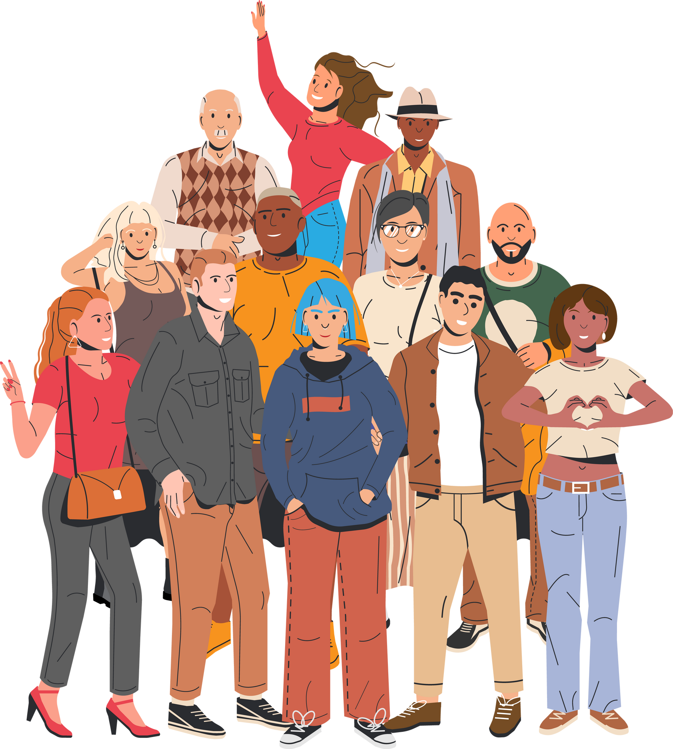
IMPORTANCE OF CULTURE
In Pakistan, culture plays a vital role in shaping the identity and social fabric of the nation. With its rich tapestry of languages, traditions, religions, and customs, culture fosters a sense of belonging and pride among diverse ethnic groups. It serves as a vehicle for preserving history, passing down values, and promoting social cohesion in a country marked by its multicultural landscape.

Slide 15


•Festivals, music, art, and cuisine reflect the unique heritage of various communities, while also promoting intercultural dialogue and understanding. Furthermore, culture influences social norms and behaviors, guiding interactions within families and communities. In a rapidly changing world, maintaining cultural practices helps strengthen societal bonds and ensures the continuity of Pakistan’s rich cultural legacy.

Slide 16
SOCIAL HARMONY
•Social harmony is a state where individuals and groups in a community live together peacefully and respectfully, despite their differences. It involves cooperation, understanding, and acceptance, allowing people to work towards common goals and resolve conflicts without violence.
•Examples:
Community Festivals: Events like local fairs, cultural festivals, or religious celebrations where people from different backgrounds come together to celebrate shared traditions and values foster social harmony. For instance, in Pakistan, Eid and Basant festivals are celebrated by diverse communities, promoting unity and understanding.

Slide 17

•Collaborative Projects: Joint community service projects, such as clean-up drives or health awareness campaigns, allow individuals from various backgrounds to work together toward a common goal, strengthening bonds and fostering teamwork.
•Art and Music Collaborations: Cultural exchanges through art and music bring people together, allowing them to appreciate different traditions. Collaborations between artists from various cultural backgrounds can create a sense of shared identity and understanding

